Slide 1
Capstone Project - The Battle of the Neighborhoods Japanese restaurant in Düsseldorf, Germany
by Heinrich Tissen, 21.03.2020

Slide 2
Table of contents
Introduction
Data
Methodology
Analysis
Results and Discussion
Conclusion

Slide 3
1. Introduction
Düsseldorf is the seventh largest city in Germany with a growing population. It has a huge variety of restaurants for every taste and, thus, to start a restaurant business in this area is not an easy task.
Our stakeholder is willing to open a japanese restaurant in the city of Düsseldorf. Since in Düsseldorf lives the largest japanese community in Continental-Europe a flourish japanese culture has been established. The idea is to jump on the bandwagon and open another restaurant offering excellent japanese cuisine.
Choosing a location for business is a stressful task, since there are a lot of criteria that have to be satisfied in order to achieve the highest revenue. Here are some of them:
the density of other restaurants
the density of specifically japanese restaurants
population density around the location
solvency of the population around the location
etc.
The target audience for this data analysis are all entrepreneurs who want to open a new Japanese restaurants or new restaurants in general. But this analysis can be interesting for different other investors and market analysts.
In this project, we will implement the basic analysis and try to find the most optimal borough to open a japanese restaurant according to those criteria. It's obvious, that there are many additional factors, such as distance from parking places or distance from the main streets, but this analysis can be done after choosing the borough, and thus will not be done within the scope of this project.

Slide 4
2. Data 2.1 Data description
Based on criteria listed above the following data will be utilized in our analysis:
the number of restaurants within the certain radius of each borough (Foresquare API)
the net income per person in each borough. It is important to consider the solvency of population. Source: Statistical report of Düsseldorf from 2015 (https://www.duesseldorf.de/fileadmin/Amt12/statistik/stadtforschung/download/statistisches_jahrbuch_2015.pdf)
the population and the population density of the borough. Source: Statistical report of Düsseldorf from 2015 (https://www.duesseldorf.de/fileadmin/Amt12/statistik/stadtforschung/download/statistisches_jahrbuch_2015.pdf)
the coordinates of the borough. Source: Open street map (https://www.openstreetmap.org/#map=12/51.2403/6.8184)

Slide 5
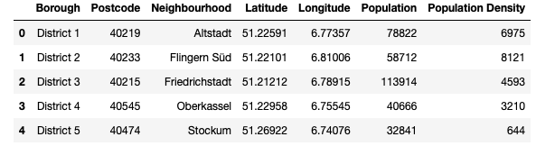
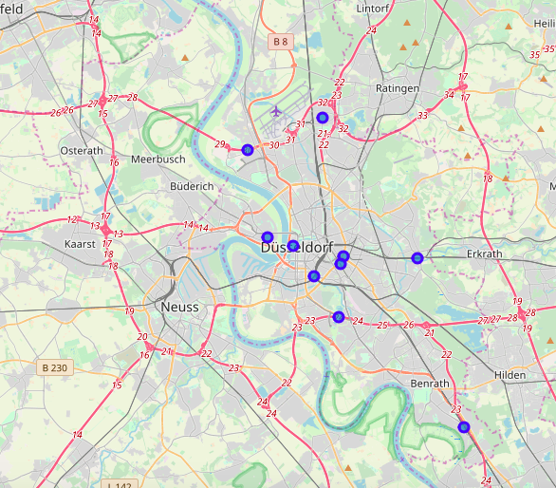
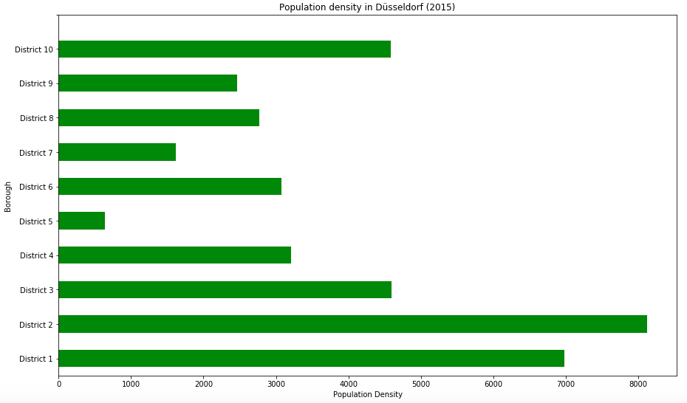
2. Data 2.2 Data preparation
This is an extract from data table. Düsseldorf consists of 10 districts.
Map of Düsseldorf
Blue bullets show a neighborhood in each borough (district 1-10)
Population density per district (inhabitants/qkm)

Slide 6
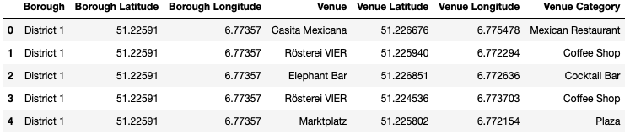
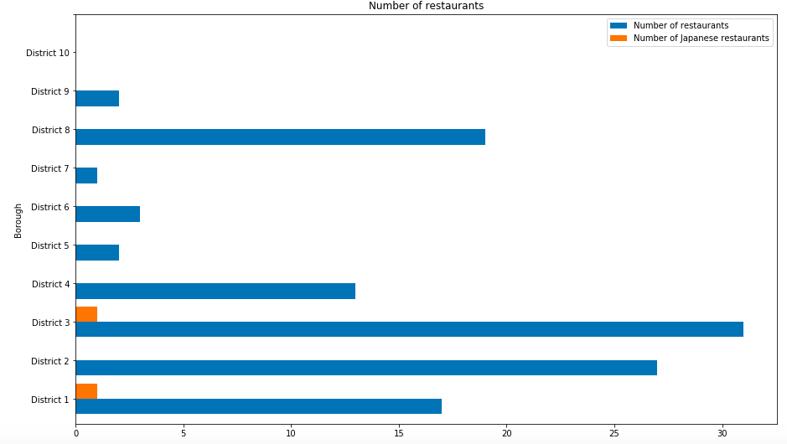
2. Data 2.2 Data preparation
Via Foursquare data of venues in Düsseldorf are imported and put into the pandas dataframe.
Number of restaurants in total and particular Japanese restaurants per district

Slide 7
4. Results and discussion
During the analysis, three bar charts were created that show a comparison between the number of restaurants (including Japanese restaurants) and the population density in each of the 10 districts of Düsseldorf.
Let´s take a deeper look at the number of restaurants first. According to the barchart most restaurants (31) are in district 3 followed by district 2 (27). The following three districts 8, 1 and 4 are very close together. The remaining districts show very low numbers in restaurants. There are no restaurants in district 10. Interesting is, that there are only 2 Japanese restaurants in total which are in district 1 and 3.
The population density shows how many inhabitants per square-kilometer in each district live. It shows peaks in district 2 and 1 with circa 8000 and 7000 people per qkm. Most other districts show figures between 2800 and 4500. Only district 7 and 5 are below 2000 and 1000.
Key in this analysis is the relation of population density and number of restaurants, which results finally in the new KPI number of restaurants per 1000 people. The last chart reveals that the lowest figures are in district 10, 9, 7, 6 and 5. This means that in these districts there is probably the lowest competition rate. In addition in these districts are no Japanese restaurants, so that another Japanese restaurant can broaden the variety of cuisine available. In all other districts the number of restaurants per 1000 people is much higher and therefore the competition.
The data analysis has some weaknesses that need to be considered here. First, the analysis for an optimal location of a restaurant needs more detailed geolocal information especially data about certain city areas and streets to be more precise. Additionally a lot more information can be added in this analysis in order to enhance the results and make a better recommendation. These coulde be information about the income situation, restaurant expenditures and average age of the inhabitants. One mistake is very obvious, Foursquare doesn't represent the full picture, since many venues are not on the list. This can be solved by using other data sources such as Google maps.
5. Results and discussion
To conclude, the data analysis was performed to identify the most optimal borough for the placement of a Japanese restaurant in the city of Düsseldorf. During the analysis, several important statistical features of the boroughs were explored and visualized. Furthermore, the KPI numbers of restaurants per 1000 people helped to find boroughs with low competition level. Finally, district 10, 9, 7, 6 and 5 were chosen in that priority as the most attractive options for the further analysis.

